Slide 1
Introducing Graphics to the Visually Impaired One Pixel at a Time

Slide 2
Introduction
Goals
Demonstrate tool
Graphics Insight
Raise Awareness

Slide 3
Background
I'm a programmer / teacher
Graphics / Pictures are powerful
Blind have limited graphics access

Slide 4
Problems
Little access to graphical presentations
Tools e.g. Braille embossers are expensive – not at everyone's desk
Access - slow/cumbersome

Slide 5
The Tool
Initial goal: Help beginners learn Programming
Extended goal: Graphics for Visually Impaired

Slide 6
Tool Benefits Provided
Braille rendition of simple graphics output
Graphics output with audio feedback
Notes:
Compromises: Lower resolution, Few colors

Slide 7
Non-programming view
Python program
a wordy nerdy "Etch A Sketch" drawing tool
Drawing Instructions

Slide 8
Draw a square
# square_loop.py
# Display a square
from turtle_braille_link import * # graphics
color("green")
for i in range(4): # Do 4 times
forward(200)
right(90)
done() # Complete drawing

Slide 9
A Demo – Hopefully Live
Following slides are reminders
offline viewing
If computer problems
Demo V/I usage…
cmd> cd Desktop\...\01_intro
cmd> python square_loop.py
Notes:
Students copy files to Desktop\braille_2023\
Simplest graphics square.py, square_loop.py

Slide 10
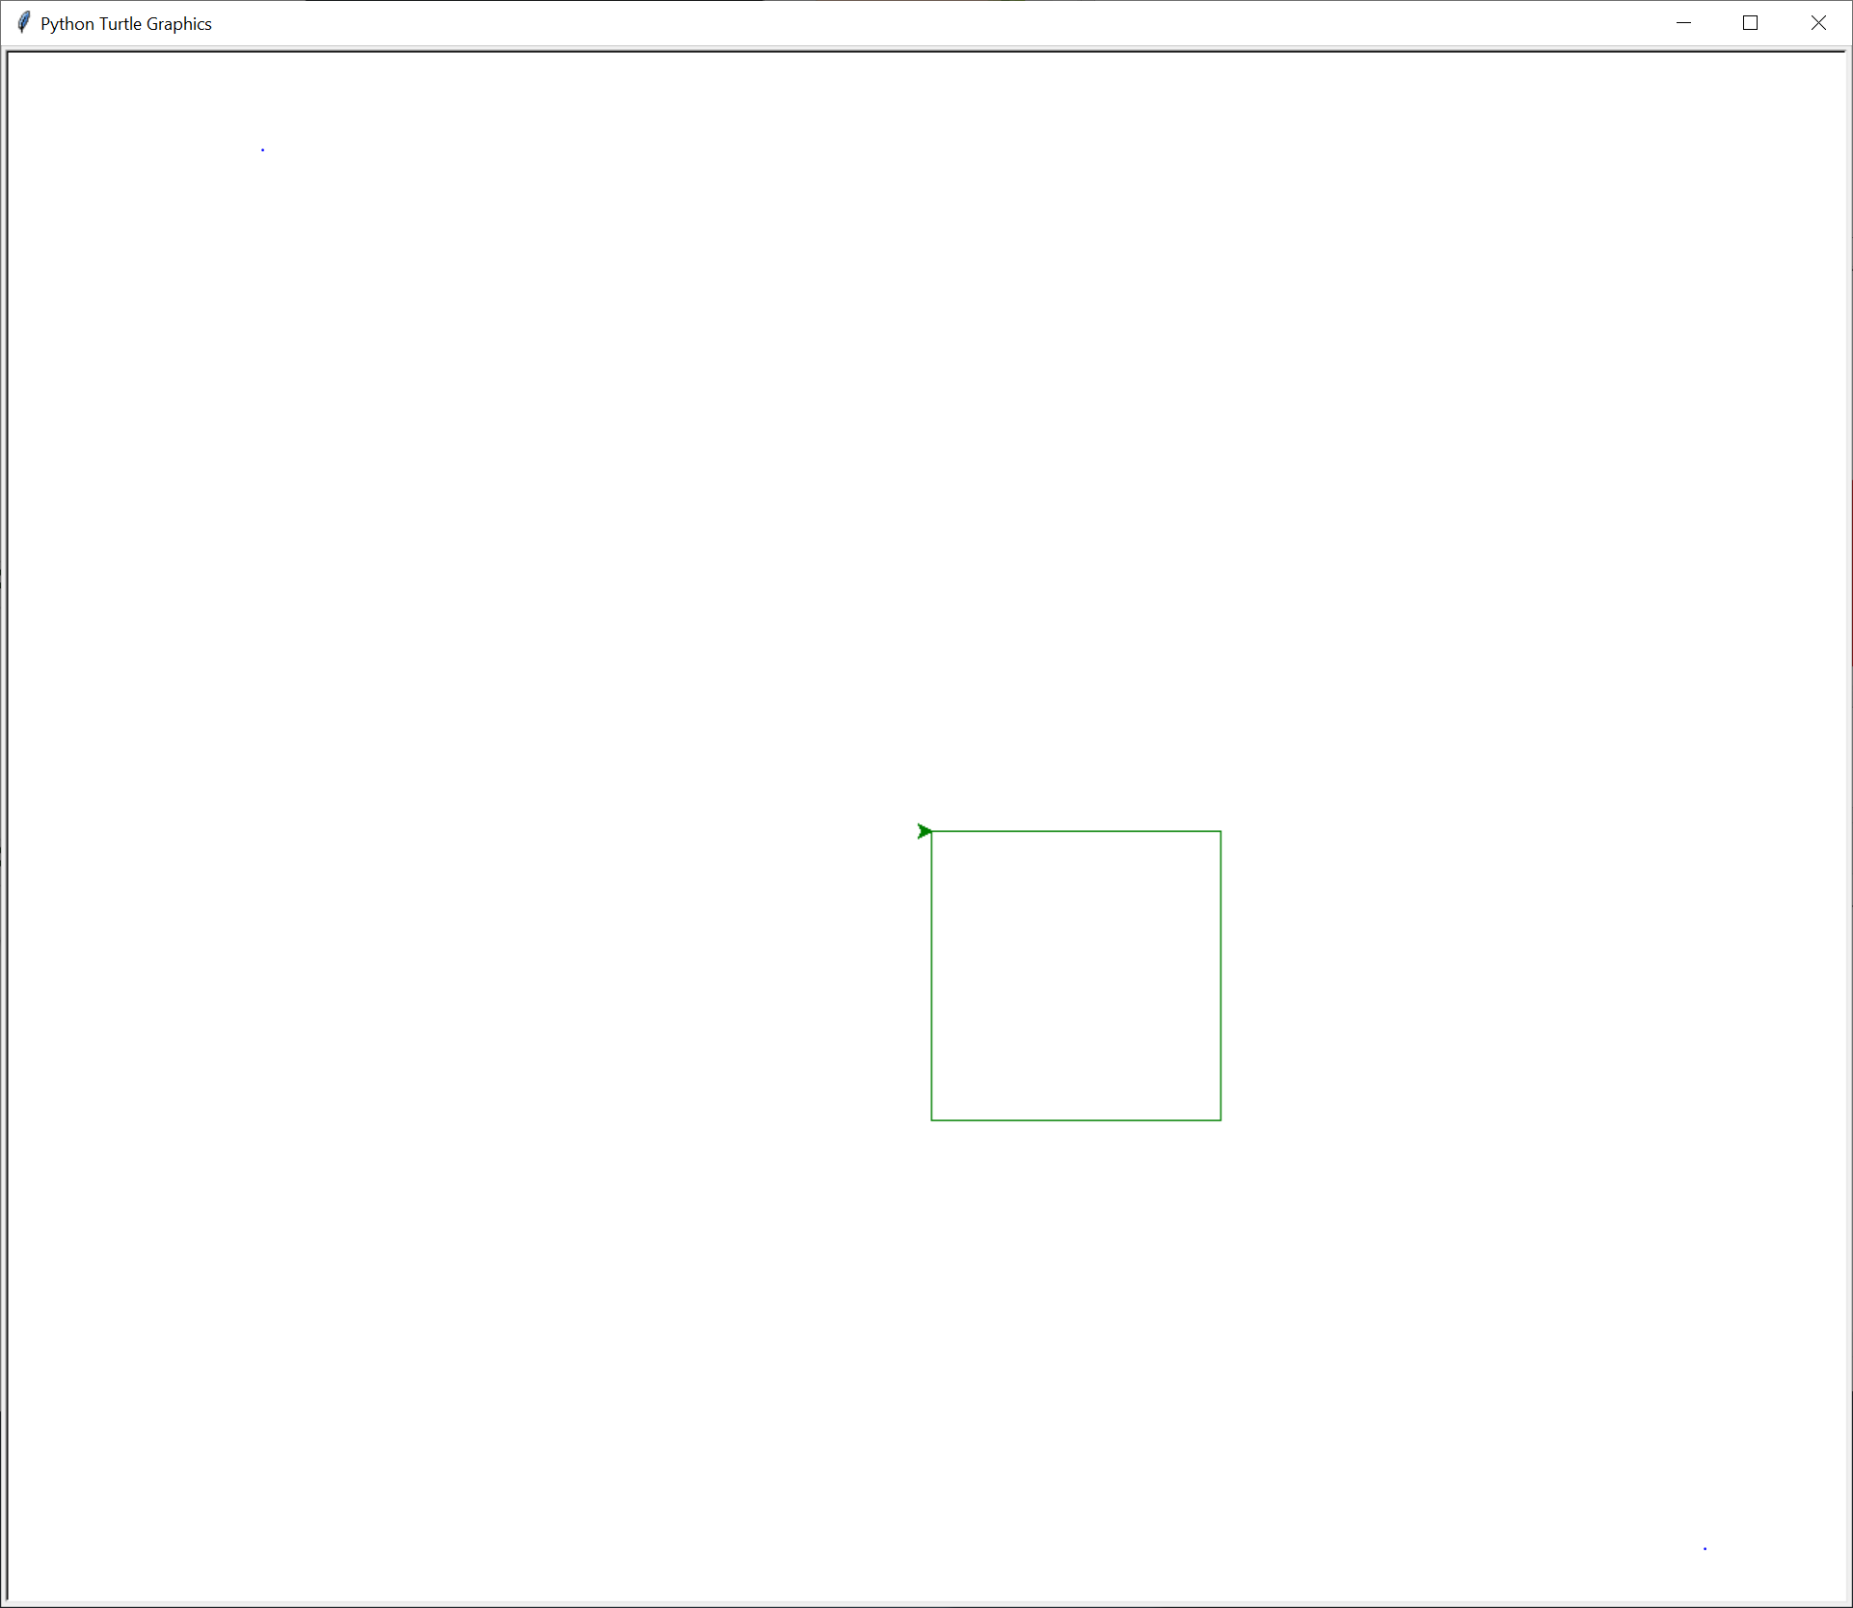
Standard turtle graphical output

Slide 11
Text output – send to Braille embosser
,,gggggggggggg
,,,g,,,,,,,,gg
,,,g,,,,,,,,gg
,,,g,,,,,,,,gg
,,,g,,,,,,,,gg
,,,g,,,,,,,,gg
,,gggggggggggg
Notes:
Commas added to keep blank area from being compressed
Figure moved to left and up to reduce effort to find figure

Slide 12
Changes to Braille text
Spaces to commas
Braille machine compresses spaces
Comma Braille:
Moving figure up to left
Facilitate finding figure

Slide 13
Braille usage steps
Copy text
Transmit Braille machine
Retrieve Braille
Slows viewing → reduces impact

Slide 14
Hope: quick change and quick view
square_loop.py
square_loop_w40.py – thicken lines
square_loop_colors.py – add colors

Slide 15
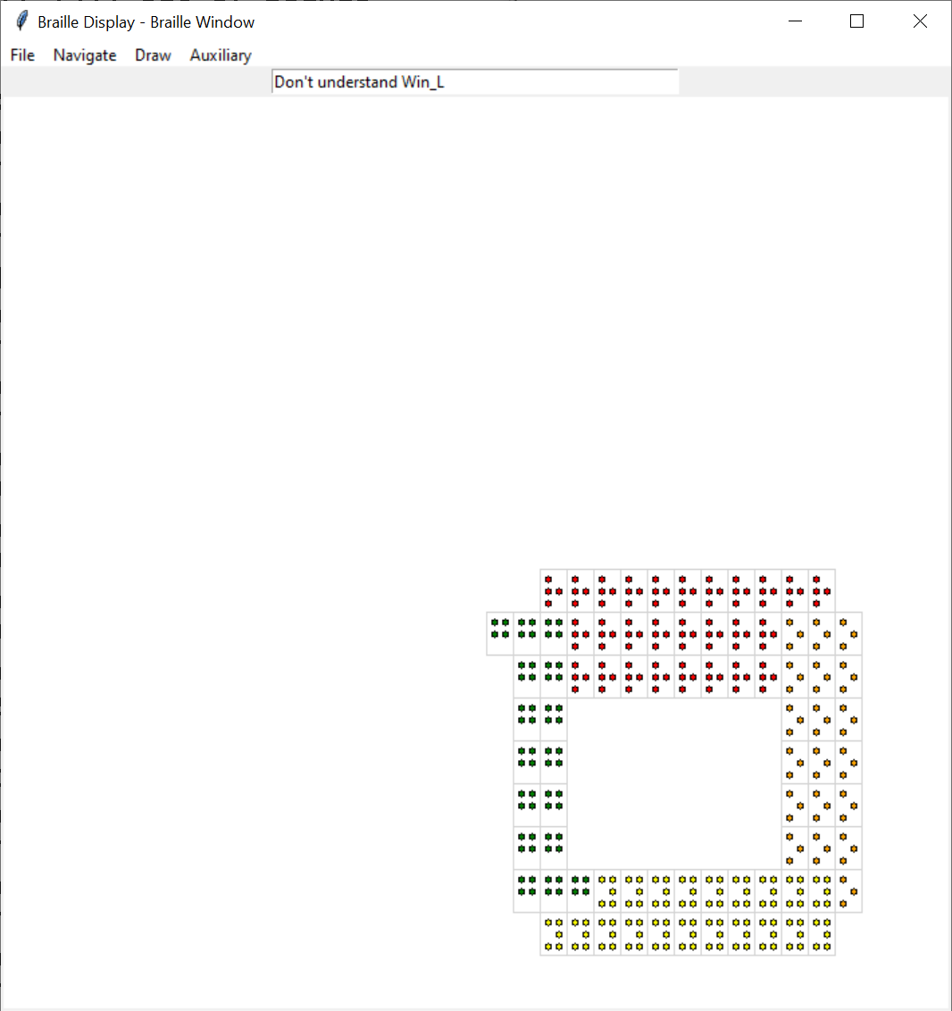
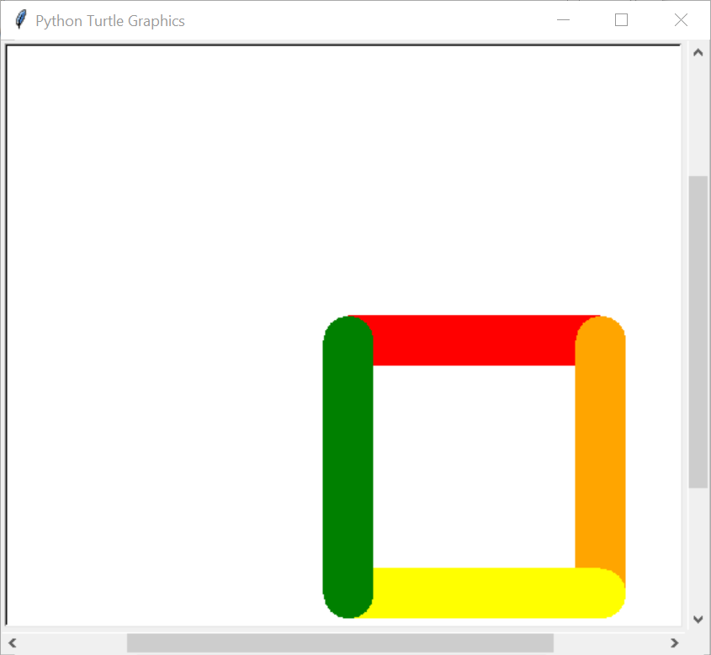
Braille Display Window with Audio Feedback
Notes:
Started as a guide to the implementor
Became an audio based guide

Slide 16
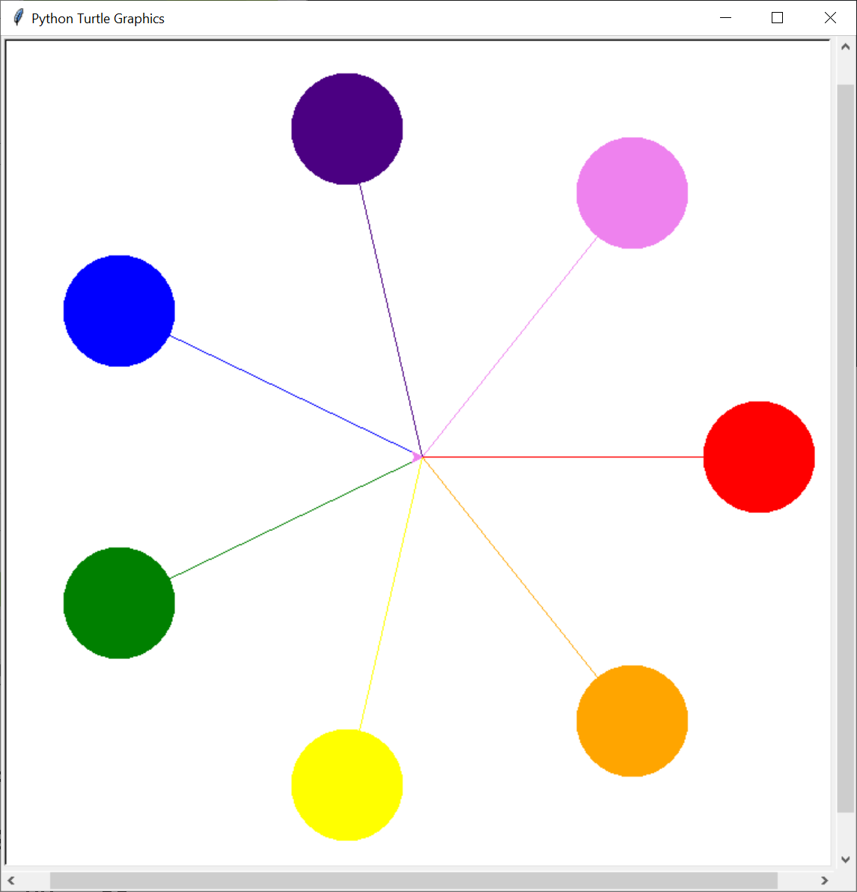
Spokes – A More elaborate figure

Slide 17
Spokes text output
,,,,,,,,,,,,,iii
,,,,,,,,,,,,iiiiii
,,,,,,,,,,,,iiiiii,,,,,,,,vvv
,,,,,,,,,,,,iiiii,,,,,,,vvvvvv
,,,,,,,,,,,,,,,i,,,,,,,,vvvvvv
,,,bbb,,,,,,,,,ii,,,,,,,,vvvvv
,,bbbbb,,,,,,,,,i,,,,,,vvv
,,bbbbbb,,,,,,,,i,,,,,vv
,,bbbbbbbb,,,,,,ii,,,vv
,,,,,,,,,,bbbb,,,i,,v,,,,,,,,,,,rr
,,,,,,,,,,,,,bbbbivv,,,,,,,,,,rrrrrr
,,,,,,,,,,,,,,,,bvvrrrrrrrrrrrrrrrrr
,,,,,,,,,,,,,ggg,yoo,,,,,,,,,,rrrrrr
… Omitted for brevity …

Slide 18
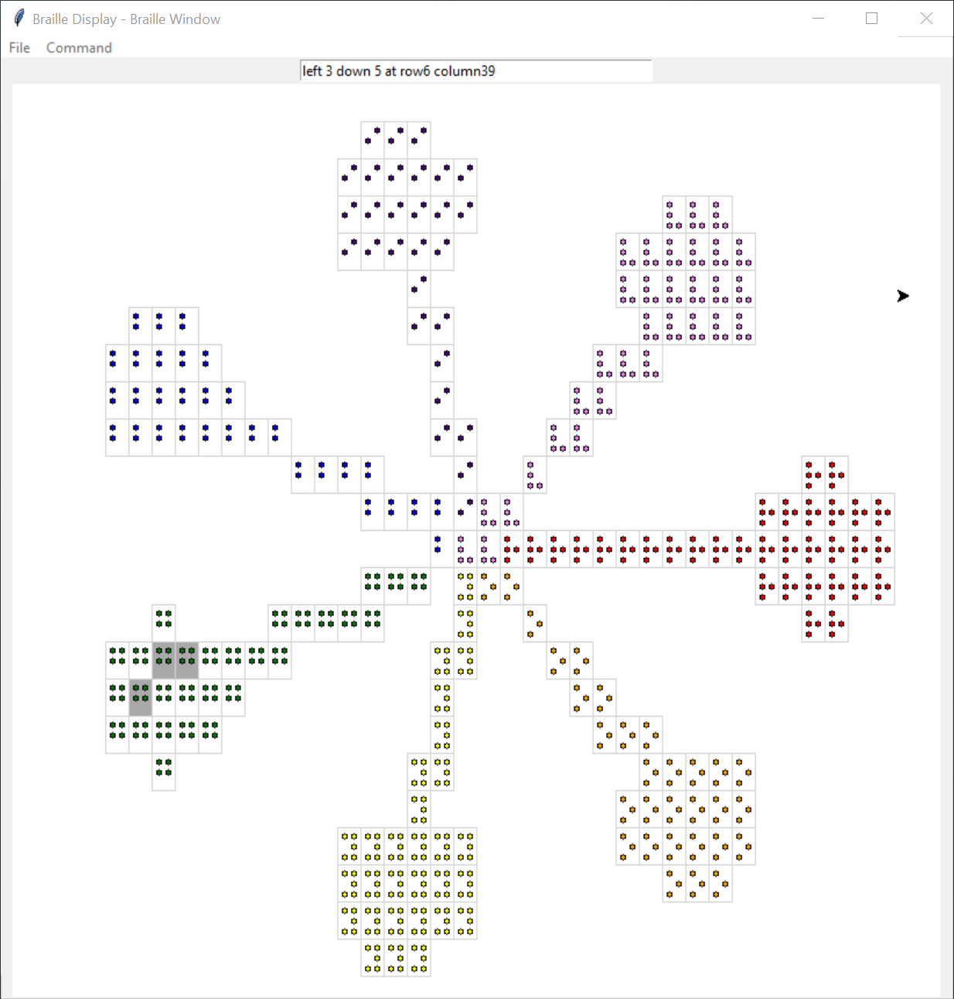
Spokes – Braille Display

Slide 19
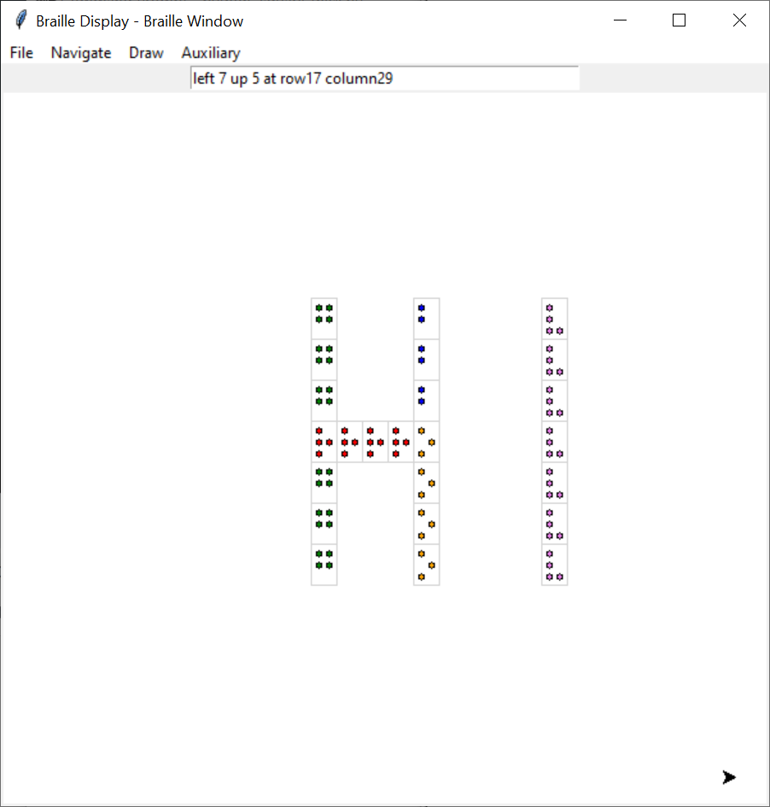
A Drawing Tool
Braille Text
,,g,,,b,,,,v ,,g,,,b,,,,v ,,g,,,b,,,,v ,,rrrro,,,,v ,,g,,,o,,,,v ,,g,,,o,,,,v ,,g,,,o,,,,v

Slide 20
Future Possibilities
Better Screen Reader Support
Port to wxPython
Speed-up scanning
Presentation Improvements
Extended magnificaton

Slide 21
Tool Question and Answer

